Slide 1
Match Each Position Graph to the Correct Description
1. Walk away from origin, speeding up
Graph A.
Graph C.
X
(m)
X
(m)
2. Stand Still
3. Walk away from origin, slowing down
t (sec)
t (sec)
4. Walk toward origin, speeding up
Graph B.
Graph D.
X
(m)
5. Walk away from origin, turn around and walk back
X
(m)
t (sec)
6. Walk toward origin, slowing down
t (sec)
Graph A____ Graph B____ Graph C____ Graph 4____
2
5
1
6

Slide 2
Match Each VELOCITY Graph to the Correct Description
Graph A.
1. Walk away from origin, speeding up, then slow down
Graph C.
V
(m/s)
V
(m/s)
0
0
t (sec)
2. Stand Still
t (sec)
3. Walk away from origin at a steady pace
Graph B.
Graph D.
V
(m/s)
4. Walk toward origin, speeding up
V
(m/s)
0
5. Walk away from origin, turn around and walk back
0
t (sec)
t (sec)
6. Walk toward origin at a steady pace
Graph A____ Graph B____ Graph C____ Graph D____
3
1
6
5

Slide 3
Which Object is Moving Faster (Greatest Speed)?
Graph 1.
Graph 3.
B
A
B
X
(m)
X
(m)
The magnitude of the slope of a position graph indicates the speed. The sign of the slope indicates the direction of the velocity.
A
t (sec)
t (sec)
Graph 4.
Graph 2.
B
A
X
(m)
A
X
(m)
B
t (sec)
t (sec)
Line A B. Line B C. Tie D. Can’t Tell
Graph 1____ Graph 2____ Graph 3____ Graph 4____
A
B
C
B

Slide 4
Which Object is Moving Faster (Greatest Speed)?
Line A B. Line B C. Tie D. Can’t Tell
B
The speed is indicated by the distance from the X axis on a Velocity graph
V
(m/s)
A
0
t (sec)
Which Object is Ahead?
Line A B. Line B C. Tie D. Can’t Tell
A velocity graph does not indicate the initial position of the object. B could have had a head start.

Slide 5
Which Object is Moving Faster (Greatest Speed)?
Line A B. Line B C. Tie D. First B, then A
E. First A, then B
Make sure you always look at the graph axes to see what type of graph it is
B
V
(m/s)
A
0
t (sec)
Which Object is Ahead?
Line A B. Line B C. Neither D. Can’t Tell
What Does the Intersection Represent?
A. They have the Same Position B. Same Velocity
C. Same Speed, Opposite Direction D. They Turn Around

Slide 6
Create a Velocity Graph from a Position Graph
(3.0, 3.5)
Slope = 0
Velocity = 0
∆x
(0.5, 1.0)
Velocity is the Slope of the Position Graph
∆t

Slide 7
Create Position Graph from a Velocity Graph
Does the Velocity Graph tell you Where to Start?
No! Need to be given the initial position

Slide 8
Line Stays at 1 m while Velocity is Zero
How Far Do You Go from 3 to 6 seconds?

Slide 9
You end up at 2.5 meter Position at 6 seconds
How Far Do You Go from 6 to 9 seconds?

Slide 10
You End Up Back Where You Started
What Does the Graph Do Next?

Slide 11
What is Average Speed While Moving?
What is the Average Velocity While Moving?

Slide 12
Area “Under” a Velocity Graph is Displacement
More Correctly, It is the Area Between the line and the X axis
0.5 m/s × 3 s = 1.5 m
-0.5 m/s × 3 s = -1.5 m
Area below X axis is negative displacement
-1.5 m
+1.5 m

Slide 13
Area “Under” a Velocity Graph is Displacement, even when Velocity Line has a Slope

Slide 14
Area “Under” a Velocity Graph is Displacement, even when the Velocity Line has a non-zero Slope
Area = 4s × .5 m/s = 2 m
Area = 1/2 × 4s × 0.5 m/s = 1m
Area = 1/2 × 2s × 0.5 m/s = 0.5 m
Decreasing Slope
Constant Slope
Increasing Slope

Slide 15
Also, Displacement is the Average Velocity times the Time

Slide 16
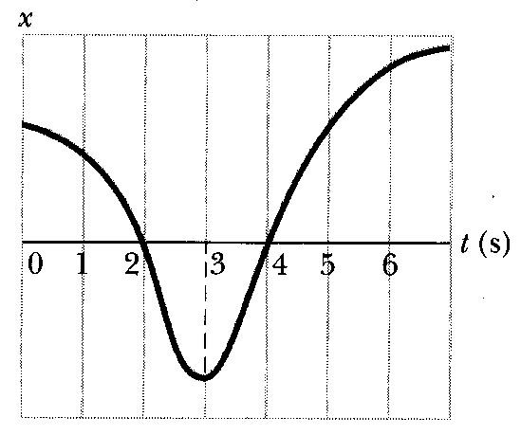
E&P #17
+
0
-
Position is negative to the left of the origin
The velocity is the slope
The velocity is the slope
1. When, if ever, is the animal to the left of the origin on the axis?
(A) never
(B) between t = 0 and t = 2
(C) none of these
(D) between t = 2 and t = 4
(E) between t = 4 and t = 7
2. When, if ever, is its velocity negative?
(A) never
(B) between t = 3 and t = 7
(C) none of these
(D) between t = 0 and t = 3
(E) between t = 2 and t = 4
3. When, if ever, is its velocity positive?
(A) always
(B) between t = 3 and t = 7
(C) none of these
(D) between t = 0 and t = 3
(E) never
4. When, if ever, is its velocity zero?
(A) around t = 1
(B) at t = 3
(C) between t = 2.5 and t = 4.5
(D) never
(E) at t = 0

Slide 17
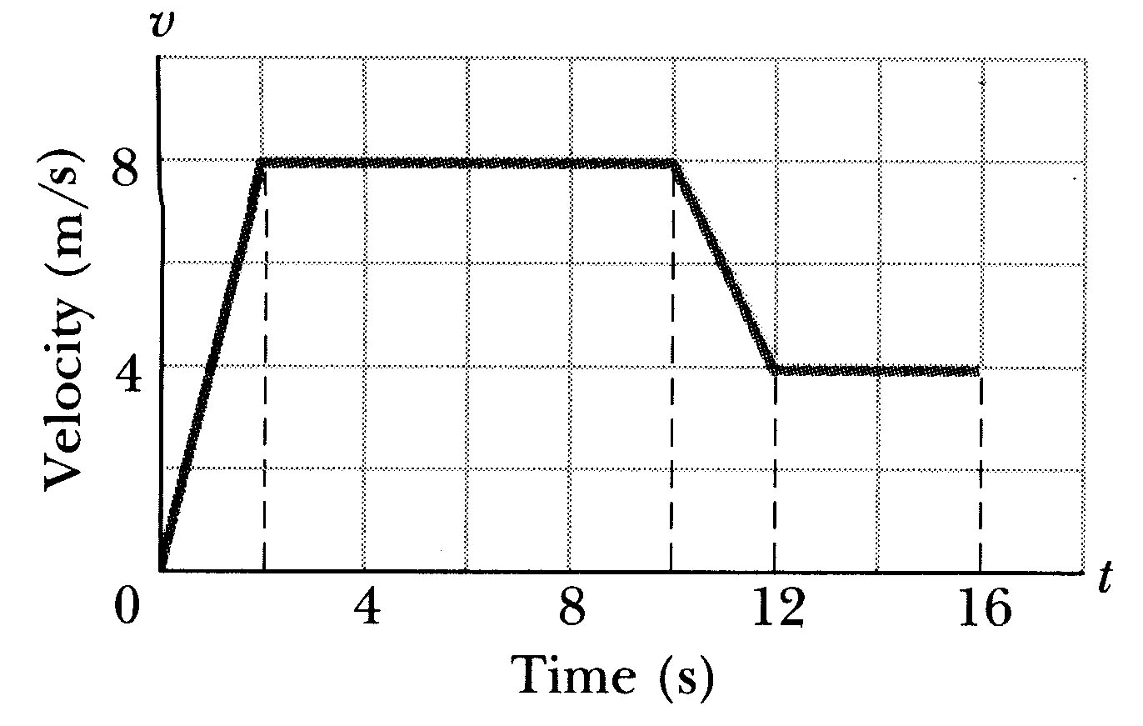
E&P #19
What is the total distance covered between 0 and 16 seconds by the runner whose velocity is shown above?
(A) 128 m
(B) 80 m
(C) 100 m
(D) Can’t tell
(E) None of the above

Slide 18
Which Graph Shows the Velocity of a Ball Thrown Straight Up, After it Leaves Your Hand?
A
V
(m/s)
V
(m/s)
B
0
0
t (sec)
t (sec)
C
D
V
(m/s)
V
(m/s)
0
0
t (sec)
t (sec)
V
(m/s)
E
0
t (sec)

